Slide 1
A Presentation on: Medical Costs Prediction
Presentd By –
Vaibhav Pathade

Slide 2
Objective:-
Predicting Medical Costs based on personal characteristics

Slide 3
Contents:-
1. Introduction of Dataset
2. Dataset Briefing
3. Data Preparation
4. Feature selection
5. Data modeling
6. Performance measurement
7. Conclusion

Slide 4
Introduction of Dataset:-
The amount of data that is uploaded to check the Medical Costs based on Personal Characteristics.
Now a days medical costs of people is increasing day by day. So, there is massive requirement to study the highly dynamic Characteristics of people which are causing the medical costs.
This is a preliminary work to model the user patterns and to study the effectiveness of machine learning predictive modelling approaches on Medical cocts based on personal Characteristics.

Slide 5
Dataset Briefing:-
Our dataset contains 7 features and total 1338 records.
The problem statement is about predicting which characteristic is more effective to lead a medical costs
Remaining 6 columns are independent variables.
These columns provide information about age, sex, BMI, Children, smoker and region

Slide 6
Data Preparation:-
Data preparation is the process of transforming raw data so that we can run it through machine learning algorithm to uncover insights or make predictions.
After importing dataset we created a Data frame using pandas library.
Data frame needs to go through different queries like dataframe.head(), dataframe.tail(), dataframe.info() and dataframe.describe() for our better understanding. Querying the dataset provides us information about total number of records, number of missing values in each features, mean and standard deviation of each feature, frequency of output variable, etc.
We checked whether data contains any missing value
We checked the outliers by plotting the box and whisker graph

Slide 7
Feature Selection :-
Feature Selection is one of the core concepts in machine learning which hugely impacts the performance of your model.
It is the process where we automatically or manually select those features which contribute most to our prediction variable or output in which we are interested. Having irrelevant features in our data can decrease the accuracy of the models and make our model learn based on irrelevant features.
For feature selection we have plotted heatmap using seaborn library in python. Main benefit of using seaborn library is it contains values of correlation matrix within it. It will reduce our effort while selecting features.
In the first step we selected only those features which provide high correlation with our target variable. Hence number of features are reduced.
It will provide good accuracy than using all the features for model building.

Slide 8
Insights
So there are 139 outliers values, which represents about 10% of all population. The decision is to not remove them because they are not so discrepant from the average values and they probably are a natual part of the population we are studying.
The proportion of 18 and 19 years old people is almost the double of the other ages;
Except by the ages of 18 and 19, the proportion of ages is very regular.
There is almost the same number of males and females people
The mean of bmi population seems to be around 30.
Most of the people doesn't have children
Most of the people don't smoke

Slide 9
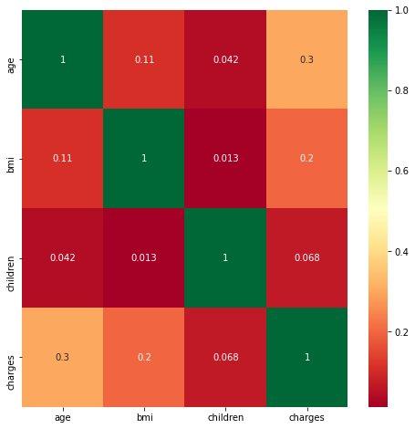
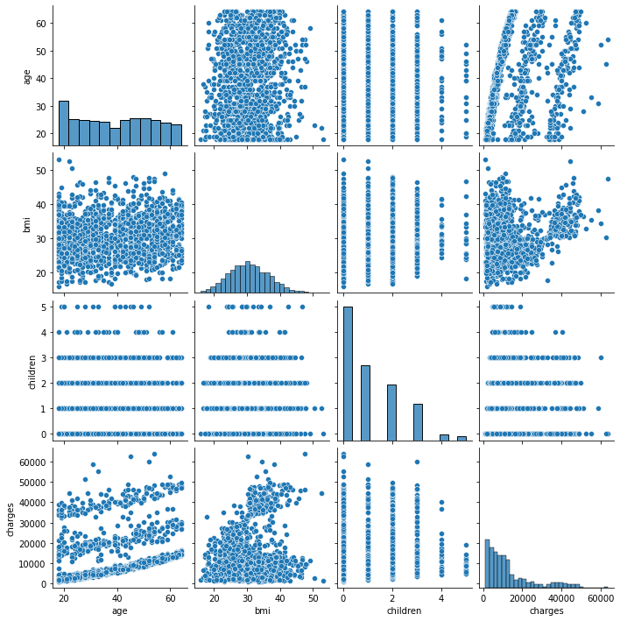
But to make sure that there isn’t any pattern which we are not aware of, we have plotted histogram and scatter plots. These graphs support our assumption about features. Hence now we can proceed for model designing.

Slide 10
charges | 1
age | 0.299008
bmi | 0.198341
children | 0.067998
sex | 0.057292
region | 0.006208
smoker | -0.78725
We can see that age, bmi and smoker (inverse correlation) has strong correlation with Charges.
And children, sex and region columns have a poor correlation with the charges column, so they will be removed from our model.

Slide 11
Data Modeling :-
These 3 features namely ‘age, ‘BMI’, ‘smoker’ are ready to model building. We have defined our target variable as ‘y’ and independent variables as ‘x’.
To get rid of outliers or noise we used normalization and standardization methods on these 3 columns.
We have used train_test_split method of sklearn library to split the dataset into 80 % for training and 20% for testing.
The sklearn library also provides different inbuilt modules for regression and classification. We tried 2 different models to get better accuracy. Those models are Linear Regression Model and Random Forest Model
The accuracy of each model is as follow:

Slide 12
Performance measurement:-
1. Linear Regression Model
Training accuracy:- 72%
2. Random Forest regression
Training accuracy:- 84%

Slide 13
Conclusion:-
smokers have more medical costs

